Slide 1
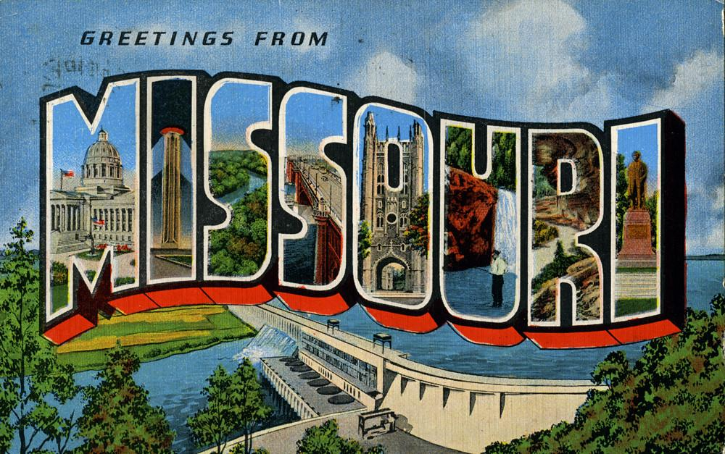

Slide 2

Meet Missouri!
Lesson Explanation Video

Slide 3
Get To Know Your State
Missouri How Did it Get its Shape? (3-6th Grade Resource)
25 Facts About Missouri (All grades)
What are two things that you think are the most interesting about Missouri?
What is one place or thing you want to know more about in Missouri?
Use the HIGHLIGHTED linked resources to discover the information you will need to respond to the prompts on the right.
Notes:
Note to teachers: if you want each student to have a copy of the presentation, simply make a copy of this original and share it with your students through your learning management platform (Google Classroom, Canvas, etc.)

Slide 4

Hello!
I am the state of Missouri!
Here are some stats you need to find out about me in order to better understand my place as the 24th State of the United States!
The more you know about my stats, the better you can understand how the state of Missouri came to be!
What year was I admitted to the UNION or the United the States of America?
What is our state Motto?
Where was our FIRST state Capitol located?
Where is our CURRENT state Capitol located?
Missouri has its own state Constitution, when was the version under which we live today created?

Slide 5
Changing Missouri
What changes would you make to the state of Missouri? Explain or illustrate your changes below. Conclude or end with telling WHY you would make those changes to the state.

Slide 6
Salus Populi Suprema Lex Esto “The welfare of the people shall be the supreme law”
What is welfare?
What does the word supreme mean?
What is the message of the motto?
What language do you think the motto is in?
Have you seen this language on any other government property?
Notes:
Welfare: The health and happiness of person or group
Supreme: above all others
Language: Latin
Found on Government Money, State Seals, Buildings, etc.

Slide 7
Examining the History of Missouri
Where did the state of Missouri get its name?
Find two Native Nations whose ancestral homeland is in present-day Missouri:
  What are the names of the Nations?
  Are these Nations federally recognized?
  Do these Nations have a reservation?
Native Nation #1 | Native Nation #2
Notes:
Have students visit Native-Land.ca | Our home on native land and type in Missouri cities or zip codes. Follow the links on the left to learn more from Nation websites.

Slide 8
Examining the History of Missouri
Which 3 nations has Missouri belonged to? (Highlight the correct response)
France, Germany, & Italy
China, Lebanon, & Syria
France, Spain, and the United States

Slide 9
Big concept
Missouri is about 300 miles long and 240 miles wide: within these miles there is a rich history of diverse people, perspectives, and lives---the more you know, the more you can show in your own life!

Slide 10
3 Famous Missourians
What to Include:
Photo
Occupation
Quote
Why you selected that person
One question you would ask them:

Slide 11
Famous Missourian #1

Slide 12
Famous Missourian #2

Slide 13
Famous Missourian #3

Slide 14
Plan A State Tour: Atlas Obscura
You are incharge of creating a ROAD TRIP through the state of Missouri.
What do you need to include?
3 State Parks:
  What you can do there?
  What can you expect to see?
  When should you go?
  Where is it?
5 Top Significant Sites:
  What makes them special to Missouri?
  Why do you want to go to this spot?
  What can you expect to do or see or learn when you are there?
  How will traveling to this place enrich your life?
(Resources: Midwest Living, Only In Your State, Roadside America Vacation Idea, Atlas Obscura: Unique & Unusual places in Missouri

Slide 15
3,2,1
What are 3 things you learned about?
1.
2.
3.
What are 2 things you knew about Missouri before this lesson?
1.
2.
What is 1 question you have about Missouri?
1.

Slide 16
Missouri Road Trip
Missouri Map Link
Insert your MY Map link of your road trip here
Reflection
What do you think is the most unique aspect about Missouri?
What do you love most about Missouri?
What would you like to see Missouri do better or have more/less of?
Connections
What places (towns/cities/parks, etc. have you been to in Missouri?
How is Missouri like other places you have visited out of state? (If you haven’t visited out state yet, how is Missouri like the places you have seen or heard about?

Slide 17
Thanks!
If you have any questions, please reach out:
You can find me in class & at user@mail.me

Slide 18
Credits
Special thanks to all the people who made and released these awesome resources for free:
Presentation template by SlidesCarnival
Photographs by Unsplash

Slide 19

Free templates for all your presentation needs
For PowerPoint and Google Slides
100% free for personal or commercial use
Ready to use, professional and customizable
Blow your audience away with attractive visuals

